Slide 1

Fairness in ML (Overview)
Rayid Ghani and Kit Rodolfa

Slide 2
Reminders
This week:
Readings for Thursday (Field Trials and Causality)
Coming up next week:
Module 3 Presentations – Preprocessing
Coming up the following week:
Module 3 Presentation Recordings (no class meetings)

Slide 3
Scope
Data
Exploration
Modeling
Get Data
Store Data
Link Data
Rows
Features
Labels
Model Selection
Train-Test Splits
Performance Metrics
Model Interpretation
Entities
temporal
Spatial
…
Models
Dealing with Bias and Fairness
Field Trial Design
Deployment
Monitoring
Goals, Actions, Data, Analysis, Ethics

Slide 4
We know data and ML can help improve society but we have to do it responsibly and ethically

Slide 5
We need to be ok with not having answers but raising more questions that can be empirically informed

Slide 6
Most of these questions are not new
Ethical issues have always existed in every decision-making process
Why are we talking about them in this class now?

Slide 7
Most of these questions are not new
Ethical issues have always existed in every decision-making process but we are dealing with them now at a different scale and with a more data-driven view

Slide 8
Our policies need to reflect our values
What do we mean by equity?
Is it ok to (reverse) discriminate against one group to reach equity?
Should our right to privacy matter more than our right to life? Or to healthcare?
Should we be allowed to use someone’s data just because it’s accessible to us?
Is predictive policing always bad?

Slide 9
We need to think of & include the perspectives of different groups
Decisionmakers
Public
Media
Analysts

Slide 10
Rawls’s Theory of Justice
Why did we ask you to read a moral philosophy text?
Moral philosophy is much more about frameworks to help approach tough problems and balance competing obligations than clear-cut answers
Rawls is far from the only voice here and many other perspectives are well worth exploring: utilitarianism (Singer), deontology (Kant), Scanlon, Sen, etc.

Slide 11
Rawls’s Theory of Justice
Make rules from the “original position” under a “veil of ignorance”
Rawls’s conclusions: equality in rights/duties & the difference principle
Maximize the position of the least-well-off in society (“maximin”)

Slide 12
Some questions we should be asking

Slide 13
Some questions we should be asking
Are you using data for purposes it’s intended for?
How are you protecting the data?
Do the people who “own” the data know you’re using it?
Do you have their permission? How was it obtained?
What actions are you taking on individuals based on this data?
Do the people you’re targeting know why and if they’re being targeted?
What recourse do they have?
Would it make the front page of NYT if they found out what you’re doing?

Slide 14
(Re)thinking how we design AI systems
What values should the AI system be designed to achieve?
How do we build it to achieve those values?
How do we validate and monitor that it continues to achieve those values?
Notes:
AI/ML systems are heavily dependent on humans to determine a wide range of aspects of their design, development, and use

Slide 15
Data and AI Ethics Issues
Privacy
Data Ownership
Bias, Equity, & Fairness
Transparency
Trustworthiness and Accountability

Slide 16
Data and AI Ethics Issues
Privacy
Data Ownership
Bias, Equity, & Fairness
Transparency
Trustworthiness and Accountability

Slide 17
The focus should not just be on making the ML model fair but rather on making the overall system and outcomes fair
Define (desired fairness or equity goals)
Understand (root causes of bias)
Improve (fairness of AI systems)
Measure and Detect (bias)
Mitigate (the impact through adjusting interventions)
Monitor & Evaluate

Slide 18
The focus should not just be on making the ML model fair but rather on making the overall system and outcomes fair
Define (desired fairness or equity goals)
Understand (root causes of bias)
Improve (fairness of AI systems)
Measure and Detect (bias)
Mitigate (the impact through adjusting interventions)
Monitor & Evaluate

Slide 19
Many Bias Measures: How do we select what we design for?
Do we allocate equal resources to every group?
Do we allocate resources proportional to need?
Do we make sure we don’t miss people with of a certain group disproportionately?
Do we make sure we don’t have disproportionate false positives from a particular group?
...

Slide 20
Many Bias Measures: How do we select what we care about?
Statistical/Demographic Parity
Impact Parity
False Discovery Rate Parity
False Omission Rate Parity
False Positive Rate Parity
False Negative Rate Parity
...

Slide 21
Why do we have to choose?

Slide 22
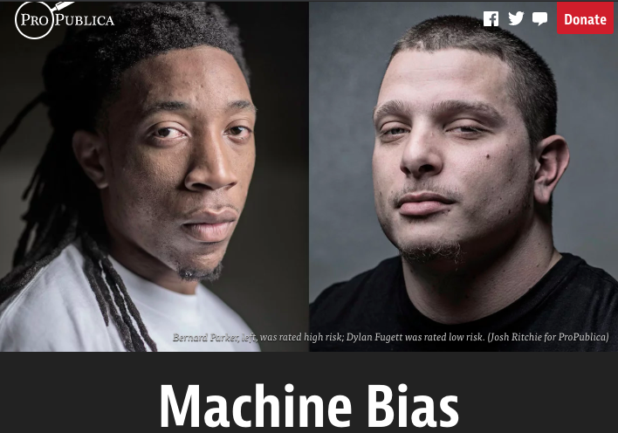
Incompatibility Between Fairness Metrics

Slide 23
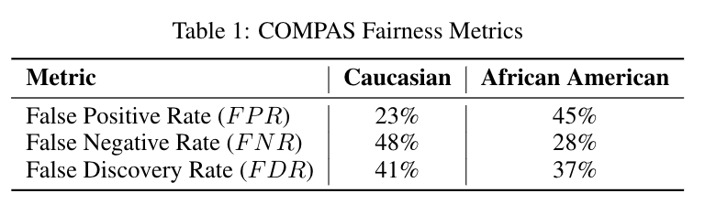
Incompatibility Between Fairness Metrics

Slide 24
Incompatibility Between Fairness Metrics
ProPublica identified considerable disparities:
The algorithm was twice as likely to incorrectly predict black individuals were at high risk of recidivating (FPR)
It was also nearly twice as likely to incorrectly predict white individuals were at low risk of recidivating (FNR)

Slide 25
Incompatibility Between Fairness Metrics
However, the creator of the algorithm pointed out that the algorithm is well-
balanced across races on precision (equivalently, FDR), claiming this is the
correct measure of fairness in this context.

Slide 26
Incompatibility Between Fairness Metrics
Who is right?
Is the COMPAS algorithm biased?
Can’t the algorithm achieve both measures of fairness at the same time?

Slide 27
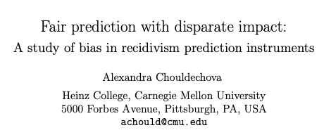
Incompatibility Between Fairness Metrics

Slide 28
Incompatibility Between Fairness Metrics

Slide 29
Incompatibility Between Fairness Metrics
False Positive Rate
Among all actual 0’s,
fraction predicted to be 1
False Negative Rate
Among all actual 1’s,
fraction predicted to be 0
Prevalence
Fraction of
actual 1’s in
population
False Discovery Rate
Among all predicted 1’s,
fraction that are actual 0’s
=(1 – precision)

Slide 30
Incompatibility Between Fairness Metrics
If prevalence is
unequal across
groups...

Slide 31
Incompatibility Between Fairness Metrics
If prevalence is
unequal across
groups...
…and FDR (or precision)
is equal across groups...

Slide 32
Incompatibility Between Fairness Metrics
If prevalence is
unequal across
groups...
…and FDR (or precision)
is equal across groups...
…then either FPR or FNR can be equal across groups, but not both

Slide 33
So… what does this mean?

Slide 34
So… what does this mean?
Sadly, no… we can’t have it all!
But this also doesn’t mean fairness is unachievable or we shouldn’t bother.
Instead, it means we have to carefully consider and choose the appropriate fairness metrics for our context

Slide 35
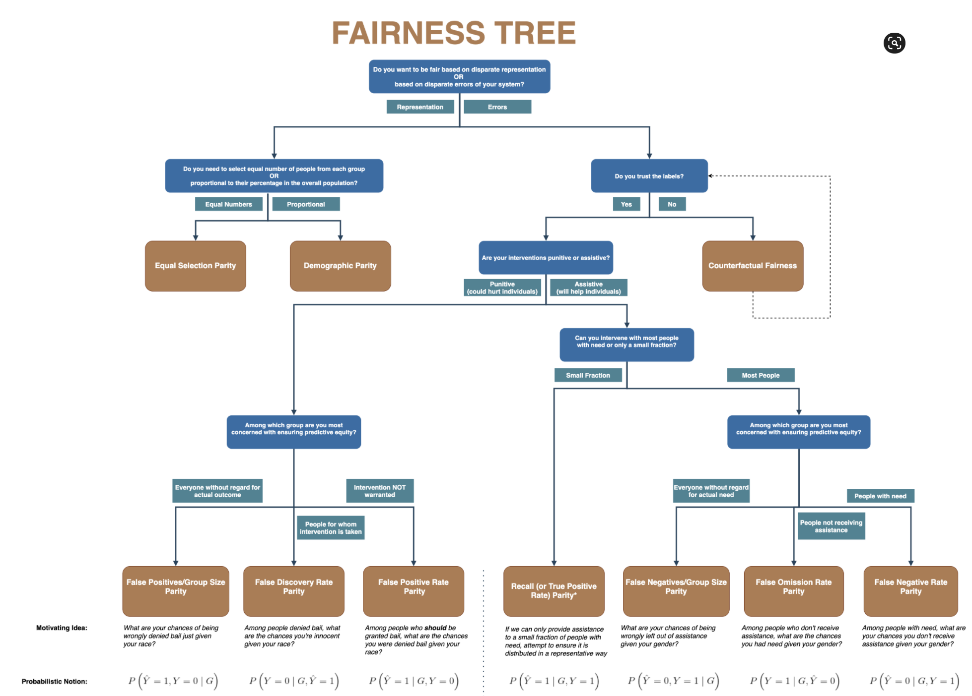
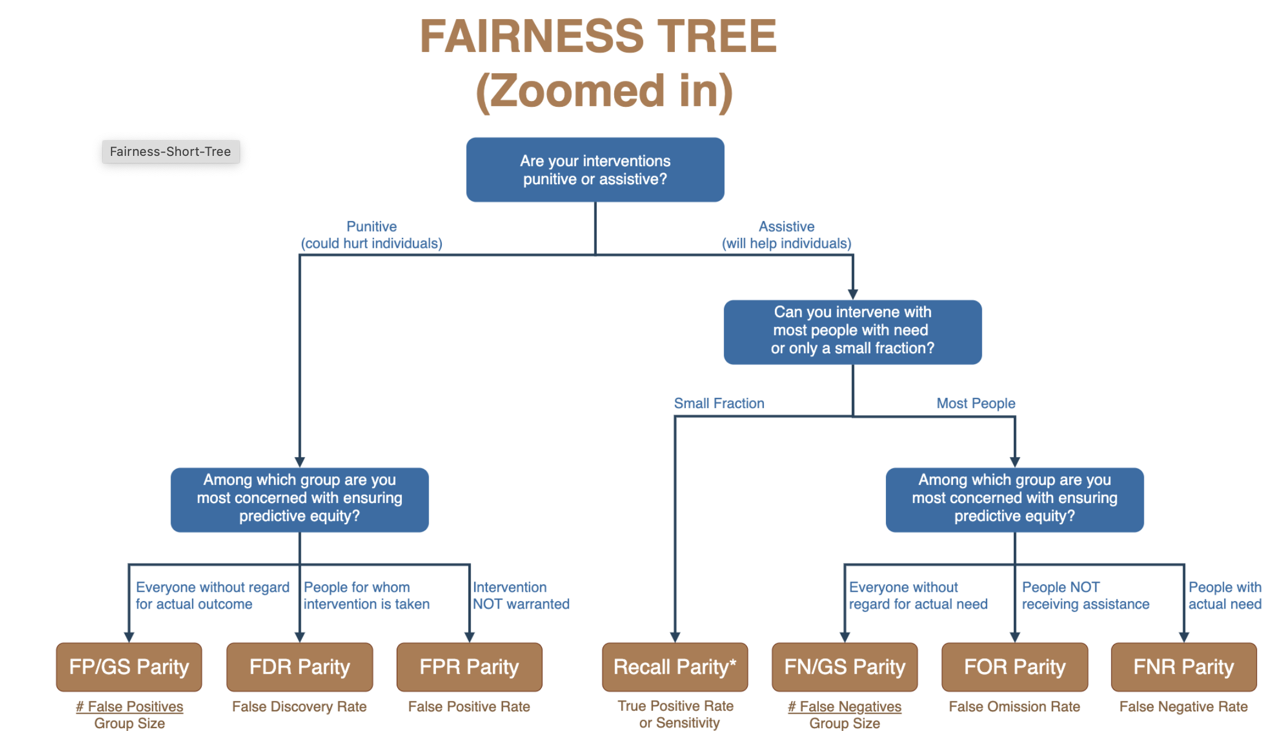

Slide 36
The focus should not just on making the ML model fair but rather on making the overall system and outcomes fair
Define (desired fairness or equity goals)
Understand (root causes of bias)
Improve (fairness of AI systems)
Measure and Detect (bias)
Mitigate (the impact through adjusting interventions)
Monitor & Evaluate

Slide 37
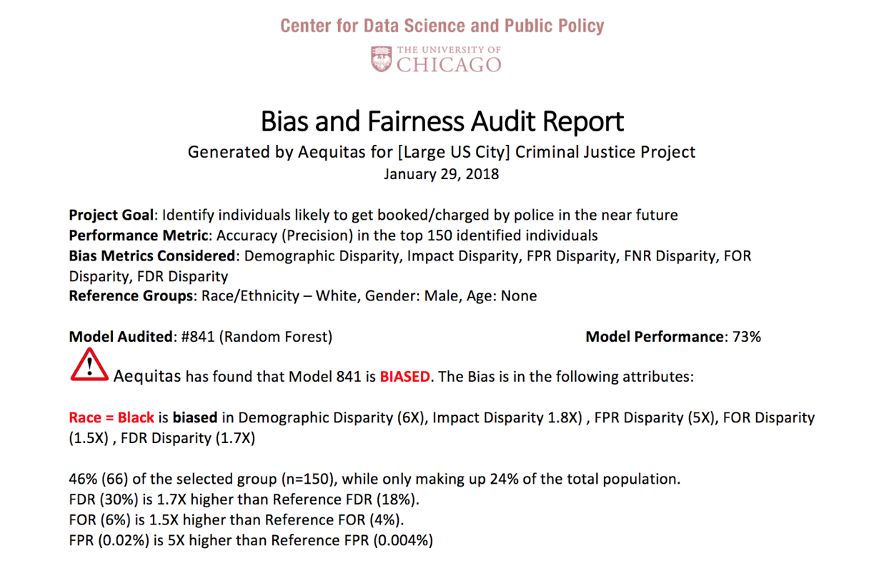

Aequitas: Bias Audit Tool
http://datasciencepublicpolicy.org/aequitas

Slide 38
The focus should not just on making the ML model fair but rather on making the overall system and outcomes fair
Define (desired fairness or equity goals)
Understand (root causes of bias)
Improve (fairness of AI systems)
Measure and Detect (bias)
Mitigate (the impact through adjusting interventions)
Monitor & Evaluate

Slide 39
Diagnosing the root causes of bias in AI/ML Systems
World
AI Pipeline
Actions
Data
Disparity in Outcomes
Bias and disparity (in outcomes) can come from any of these four components
Sample Bias
Measurement Bias
Label Bias
System Developers
Complexity or flaws
Design Choices

Slide 40
Bias can be introduced in every step of the ML pipeline
Get Data
Store and Link Data
Process Data
Explore Data
Modeling
Communicate
Maintain
Deploy
Evaluate & Select
Test

Slide 41
The focus should not just on making the ML model fair but rather on making the overall system and outcomes fair
Define (desired fairness or equity goals)
Understand (root causes of bias)
Improve (fairness of AI systems)
Measure and Detect (bias)
Mitigate (the impact through adjusting interventions)
Monitor & Evaluate

Slide 42
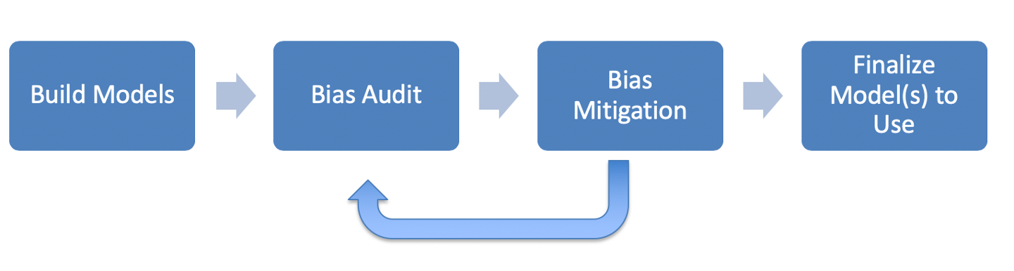
ML Fairness Workflow

Slide 43
How can we reduce bias in ML models?
Fix the world
Pre-Processing: Fix the input data
Remove sensitive attributes (and correlated ones)
Resample and/or reweight protected groups
In-Processing: Optimize for fairness in model training
Post-Processing
Choose fair models during model selection
Post-hoc adjustments to ‘de-bias’ model scores

Slide 44
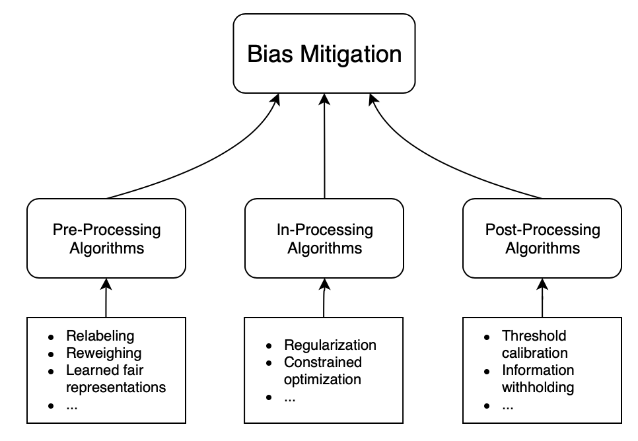
How can we reduce bias in ML models?

Slide 45
What’s the Best Approach?
We’ll explore this question in the next several sessions…

Slide 46
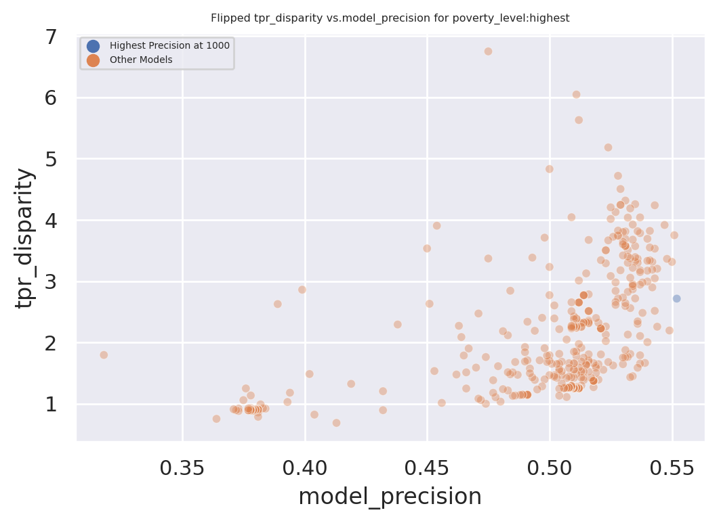
Exploring Trade-Offs
Each point is a different
model specification
Disparity
Precision@k

Slide 47
Exploring Trade-Offs
Each point is a different
model specification
Points further to the right
are more accurate
Disparity
Precision@k

Slide 48
Exploring Trade-Offs
Each point is a different
model specification
Points further to the right
are more accurate
Points closer to 1 on the
y-axis are more fair
Disparity
Precision@k

Slide 49
Exploring Trade-Offs
Disparity
“Best” model just based
on top k precision
Precision@k

Slide 50
Exploring Trade-Offs
Disparity
Pareto Frontier
Precision@k

Slide 51
Exploring Trade-Offs
Disparity
Our hope:
Fairness-improving
methods can expand this
frontier by adding new
points
Precision@k

Slide 52

Case Study: Reducing Misdemeanor Recidivism through Diversion and Social Service Programs
Predictive Fairness to Reduce Misdemeanor Recidivism Through Social Service Interventions. Rodolfa et al. ACM FAT* 2020
UNMET
NEEDS
MISDEMEANOR
ARREST
JAIL
worsening or failing to improve
Notes:
Unmet needs might include homelessness, unemployment, substance abuse/addiction, mental health issues, etc.
Not suggesting these are only factors in crime/arrests, but believe they are important contributors

Slide 53
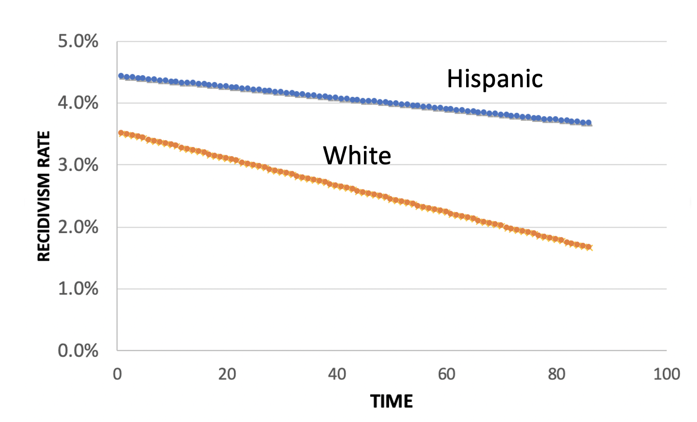
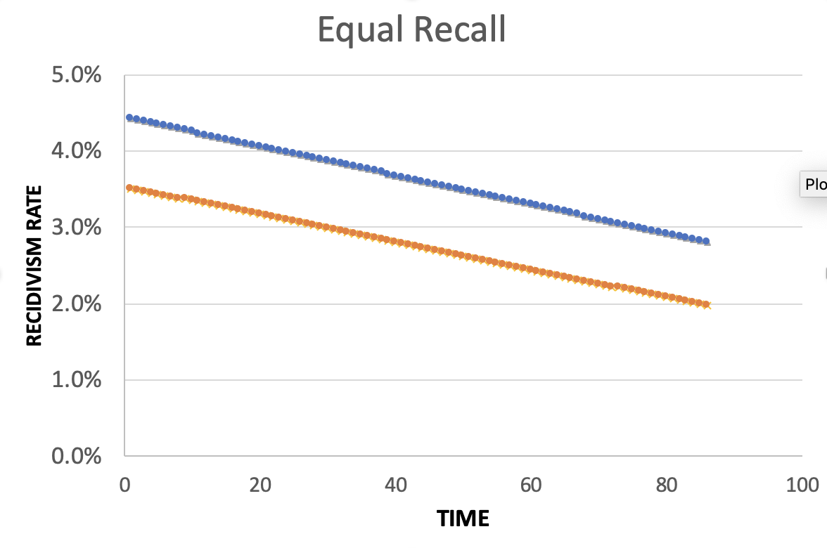
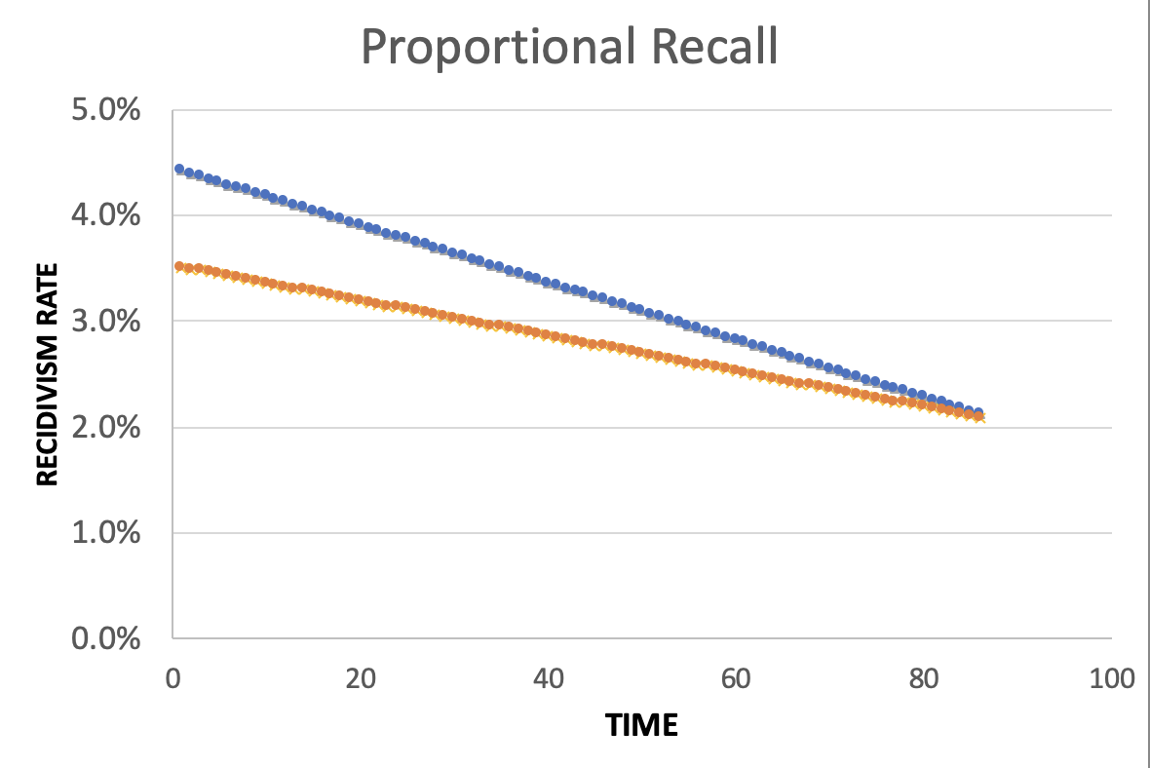
Policy Menu
Designing for Efficiency
72.7% Efficient
Equality
Additional Cost: 2%
Equity
Additional Cost: 2%

Slide 54
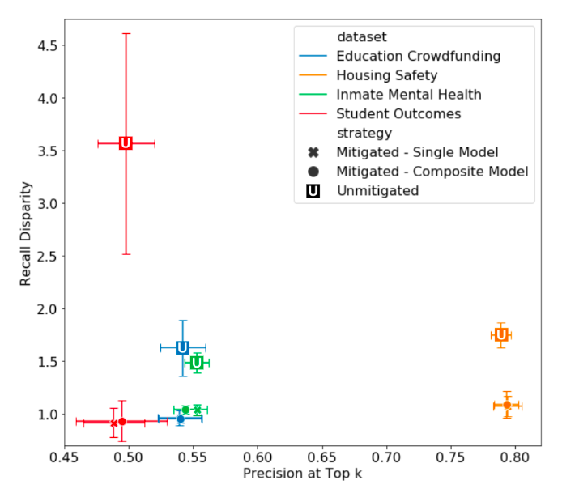
Bias
No Disparity
“Accuracy”

Slide 55
We may not have to sacrifice accuracy in order to get fairness but we do have to deliberately and explicitly design our AI systems for equity and fairness

Slide 56
Some common practitioner (mis)perceptions
Not using race in my models makes by models not racist
Using race in my models makes my models racist
Bias comes from and can be fixed by “fixing” the data
I have to eliminate all bias in order to use/deploy an ML system
I have to satisfy all measures of bias in order to be fair
There is always a tradeoff between fairness and accuracy
A fair ML model = Fair and equitable outcomes
Bias reduction methods actually reduce bias

Slide 57
How to get ready?
Create an environment where informed “values” discussions can take place
Talk through value choices at each stage of the project (instead of waiting till the end): formulation to data collection to analysis to action to impact
Consider how it affects people throughout the chain – especially the people being affected (and include them in these discussions and decisions)
Match the design to deployment scenarios
Measure outcomes – but the right outcomes
Test, Test, Test – but the right tests
Monitor and Update

Slide 58
Useful Resources
Data Science Project Scoping Guide
Open Source Data Science Tools
Triage: ML Toolkit
Aequitas: Bias Audit Tool
Code for all projects: www.github.com/dssg
Hands-on Fairness and Bias Tutorial with interactive Jupyter Notebooks
Data Science for Social Good Fellowship

Slide 59
Reminders
This week:
Readings for Thursday (Field Trials and Causality)
Coming up next week:
Module 3 Presentations

Slide 60
Appendix

Slide 61
Legal and Social Principles
Choices about fairness and equity are implicit in any decision process but being made explicit by the growing use of algorithmic decision support.

Slide 62
Legal and Social Principles
Choices about fairness and equity are implicit in any decision process but being made explicit by the growing use of algorithmic decision support. What implicit choices about fairness are encoded when we say…
Beyond a reasonable doubt? (e.g., criminal court)
The preponderance of evidence? (e.g., civil court)
Probable cause? (e.g., indictment by grand jury)
Innocent until proven guilty?

Slide 63
Legal Perspectives and Challenges
Title VII of US Civil Rights Act – Job Discrimination
Disparate Treatment (intentional discrimination)
Disparate Impact (regardless of intention)
14th Amendment
Equal Protection (under laws and government actions)
“Strict Scrutiny” Standard: compelling state interest, narrowly tailored, and least restrictive means
Notes:
14th Amendment often interpreted to prohibit racial classification in most cases (that is, taking race into account in state decision-making) as well as racial intentions/discriminatory purpose

Slide 64
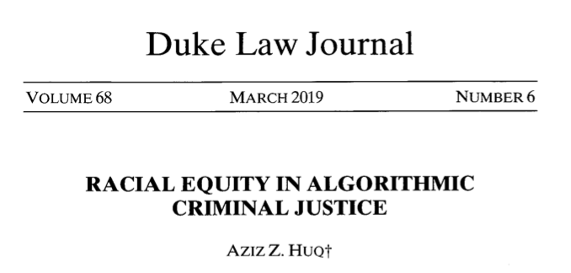
Legal Perspectives and Challenges

Slide 65
Legal Perspectives and Challenges
What Challenges Does Huq Identify Applying Current Legal Standards to Algorithmic Decision Making?

Slide 66
Legal Perspectives and Challenges
What Challenges Does Huq Identify Applying Current Legal Standards to Algorithmic Decision Making?
Expanded scale and reach of state power
Durability of errors – need for special skills to update/fix problems
What does “discriminatory intent” mean in this context?
Unclear how to apply “anticlassification” standard of equal protection

Slide 67
Legal Perspectives and Challenges
Difficulties with Equal Protection’s “Anticlassification” Standard:
Simply omitting race as a feature doesn’t ensure an algorithm is “colorblind” – too much correlated information in other features
Accounting for race may in fact be needed to decrease disparities

Slide 68
Legal Perspectives and Challenges
Drug Possession Rates
 | Black | White
Baseball Cap | 0% | 100%
No Cap | 2% | 2%

Slide 69
Legal Perspectives and Challenges
Drug Possession Rates
 | Black (25% of Pop.) | White (75% of Pop.)
Baseball Cap | 0% | 100%
No Cap | 2% | 2%
Race-Blind Policy:
75% Precision
Many Needless Searches of Minorities

Slide 70
Legal Perspectives and Challenges
Drug Possession Rates
 | Black (25% of Pop.) | White (75% of Pop.)
Baseball Cap | 0% | 100%
No Cap | 2% | 2%
Race-Aware Policy:
100% Precision
No Needless Searches of Minorities

Slide 71
Legal Perspectives and Challenges
How does Huq suggest modifying our criteria for assessing discrimination in this new context?

Slide 72
Legal Perspectives and Challenges
“Rather than asking about abstract definitions of fairness, a criminal justice algorithm should be evaluated in terms of its long-term, dynamic effects on racial stratification… [and] focus on the net burden thereby placed on the racial minority.”

Slide 73
Three Concepts of Fairness in ML
We’ve focused here on the concept of group fairness – balancing aggregate metrics across groups
Some also study the concept of individual fairness – that similar individuals should be treated similarly
An important related line of work concerns counterfactual fairness – how would your prediction if you were a member of a different group?

Slide 74
Practical Challenges with Individual Fairness
How do you measure “similarity”? Over what distance metric and what features?
Individual fairness doesn’t guarantee group fairness (but also vice-versa)
In the light of existing or historical discrimination, the protected attribute / group membership might be an important measure of dissimilarity in itself

Slide 75
Where does this leave us?
What can we do to understand bias and improve fairness of our systems?
Bias and equity audits
Try to fix the input data
Optimize for fairness in model training
Choose fair models during model selection
Post-hoc adjustments to de-bias model scores
Measure relative effectiveness of interventions across groups and develop better-tailored interventions

Slide 76
Post-Processing
Case Study

Slide 77
Case Study: Post-hoc Adjustments and Policy Goals
Cycle of Incarceration
UNMET
NEEDS
MISDEMEANOR
ARREST
JAIL
worsening or failing to improve

Slide 78
Case Study: Post-hoc Adjustments and Policy Goals
Breaking the Cycle
UNMET
NEEDS
X
MISDEMEANOR
ARREST
JAIL
TAILORED
INTERVENTION

Slide 79
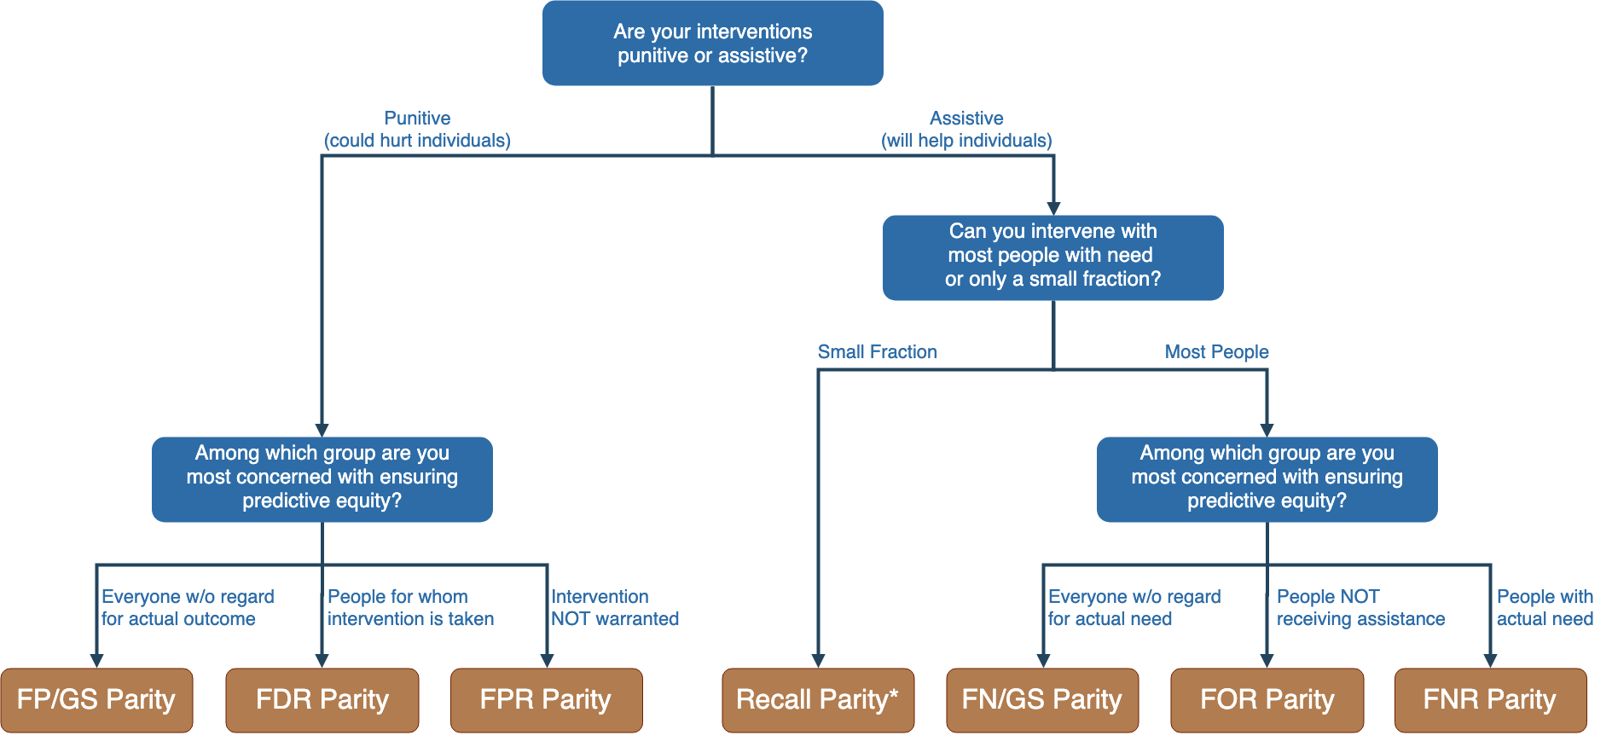
Notes:
Context-dependence of fairness definition
Idea of fairness tree is starting point for conversations with stakeholders, help guide discussion
In assistive program with resource constraints, focus on recall parity (equivalent to equality of opportunity discussed by Hardt and others --- also “sensitivity” and TPR and 1-FNR)

Slide 80
Notes:
Context-dependence of fairness definition
Idea of fairness tree is starting point for conversations with stakeholders, help guide discussion
In assistive program with resource constraints, focus on recall parity (equivalent to equality of opportunity discussed by Hardt and others --- also “sensitivity” and TPR and 1-FNR)

Slide 81
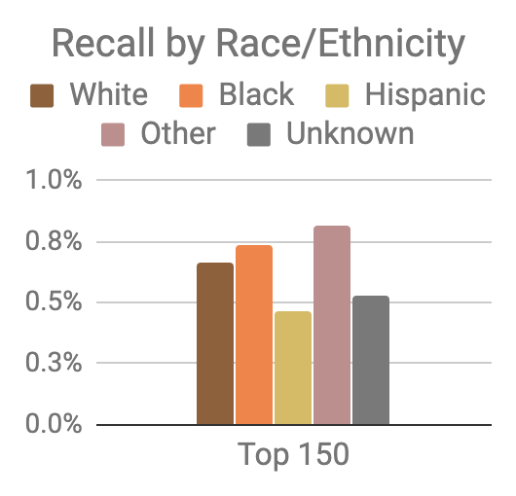
Model was optimized for efficiency, not equity
Top 150 highest risk reasonably balanced between black and white individuals
However, hispanic and unknown race/ethnicity groups very underrepresented

Slide 82
Mitigating Disparities
Single Threshold
White
Black
Hispanic
Recall
Lower Scores / Higher Recall
Group Thresholds
Recall

Slide 83
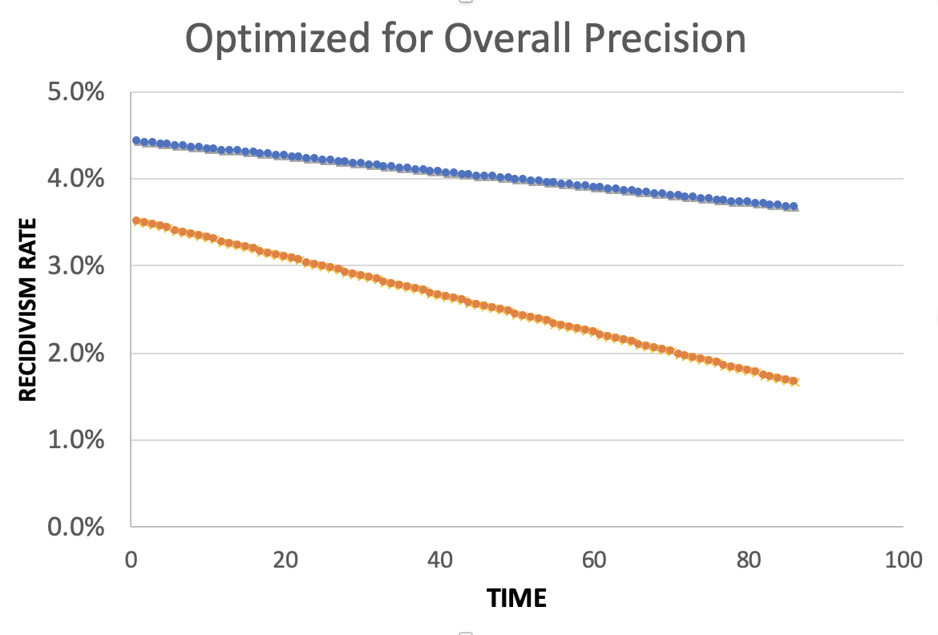
Equality of Predictions vs Underlying Disparities
Widening Gap:
Disparities Getting
Larger Over Time

Slide 84
Equality of Predictions vs Underlying Disparities
Parallel Lines:
Disparities Remain
Constant Over Time

Slide 85
Equality of Predictions vs Underlying Disparities
Converging Lines:
Disparities Decrease
Over Time

Slide 87
Menu of Options
Current Scale
Expanded Scale
No
Constraint
Equalize
Recall
Reduce
Disparities

Slide 88
Menu of Options
Current Scale
Expanded Scale
No
Constraint
INITIAL
MODEL
Equalize
Recall
Reduce
Disparities

Slide 89
Menu of Options
Current Scale
Expanded Scale
No
Constraint
Equalize
Recall
EXPLICIT
EQUITY / EFFICIENCY
TRADE-OFF
“COST OF
EQUITY”
Reduce
Disparities

Slide 90
Menu of Options
Current Scale
Expanded Scale
No
Constraint
Equalize
Recall
IMPROVE OUTCOMES AT SAME
RATE ACROSS GROUPS
Reduce
Disparities
IMPROVE OUTCOMES FASTER FOR GROUPS
WITH HIGHER INCARCERATION RATES
Notes:
For the “Reduce Disparities” options, we targeted recall levels in proportion to underlying prevalence in the population. Could make other choices, but this has the nice property of readjusting as these prevalences change while also still distributing resources across all groups, but one could reasonably take many possible approaches.

Slide 91
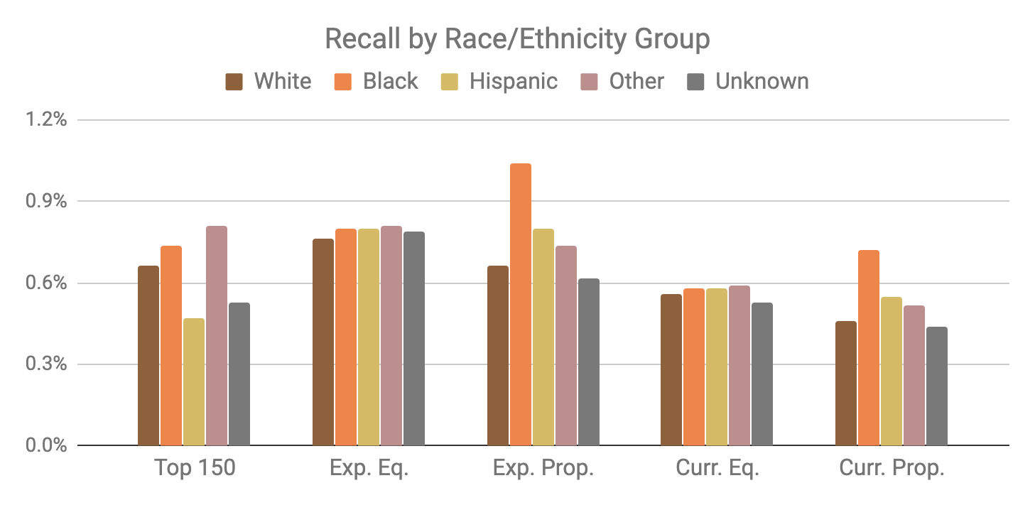
Base Model
Expanded Scale
Current Scale

Slide 92
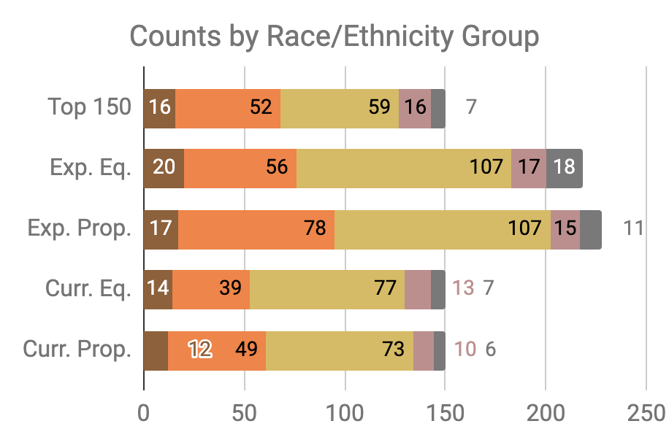

Slide 93
Little Equity/Efficiency Trade-Off at Current Scale
Top 150
72.7%
Precision
150
Total Count
Equal
Recall
70.7%
Precision
150
Total Count
Proportional
Recall
70.7%
Precision
150
Total Count

